Slide 1
Object-Oriented Programming C++ - Classes

Slide 2
The idea of OO programming is to model the features (properties or attributes) and behavior of real-world objects in the problem domain by software objects (instances).
The class construct provides a template (or blueprint) for the creation of objects.
Classes specify what attributes and behavior an object may have.
May create many objects from a given class
- Each object will have its own attribute, but will have identical behavior.

Slide 3
Important Concepts for OO Programming
Abstraction
Extract only the relevant properties of a real-world of or developing a class while ignoring the inessentials.
Encapsulation
Group the attributes and behavior of an object together in a single data structure known as a class
Information Hiding
Hide and protect essential information of the class from outside functions through a controlled interface

Slide 4

OO Feature - Abstraction
For any problem, extract the relevant real-world object properties for software objects, while ignoring inessentials
  Defines a view of the software object
Example - car
  Car dealer views a car from selling features standpoint
    Price, length of warranty, color, …
  Mechanic views a car from systems maintenance standpoint
    Size of the oil filter, type of spark plugs, …

Slide 5
Encapsulation and Information Hiding
Steps
  Decompose an object into parts
  Hide and protect essential information
  Supply an interface that allows an object to be accessed in a controlled and useful manner
Interface means that the internal representation of a class can be changed without affecting other system parts
Example - Radio
  Interface consists of controls and power and antenna connectors
    The details of how it works is hidden
  To install and use a radio
    Do not need to know anything about the radio’s electronics

Slide 6
OO Feature - Modularity
Dividing an object into smaller pieces or “modules” so that the object is easier to understand and manipulate.
Most complex systems are modular
Example - Car can be decomposed into subsystems
  Cooling system
    Radiator Thermostat Water pump
  Ignition system
    Battery Starter motor Spark plugs

Slide 7
OO Feature - Hierarchy
Hierarchy
  Ranking or ordering of objects based on some relationship between them
Helps us understand complex systems
  Example - a company hierarchy helps employees understand the company and their positions within it
For complex systems, a useful way of ordering similar abstractions is a taxonomy from least general to most general

Slide 8
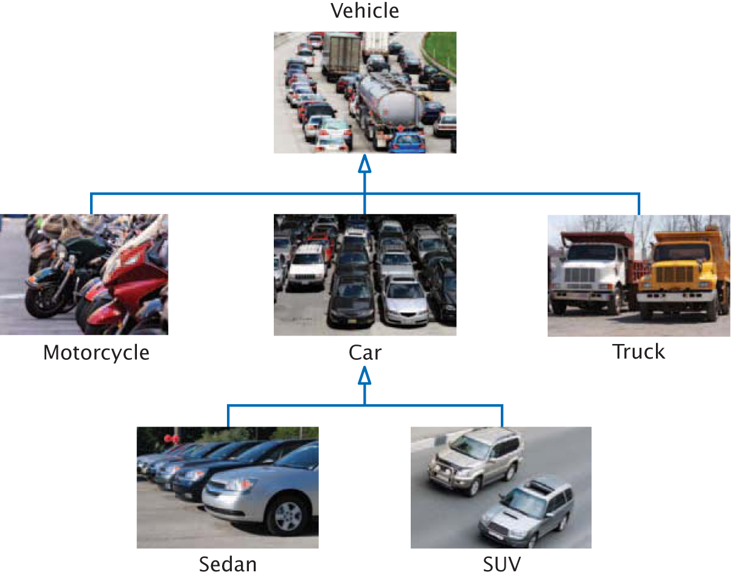
Inheritance Hierarchies

Slide 9
The 3 Main OOP Characteristics
Data Encapsulation and Information Hiding
  Data and functions are said to be encapsulated into a single entity – the class
  Data is concealed within a class, so that it cannot be accessed mistakenly by functions outside the class.
Inheritance
Polymorphism

Slide 10
The 3 Main OOP Characteristics
Data Encapsulation and Information Hiding
Inheritance
  The process of creating new classes, called derived classes, from existing classes or base classes creating a hierarchy of parent classes and child classes.
  The child classes inherit the attributes and behaviour of the parent classes.
Polymorphism

Slide 11
The 3 Main OOP Characteristics
Data Encapsulation and Data Hiding
Inheritance
Polymorphism
  Generally, the ability to appear in many forms
  More specifically, in OOP, it is the ability to redefine methods for derived classes
  Ability to process objects differently depending on their data type or class
  Giving different meanings to the same thing

Slide 12
Class Construct
Allows the definition of specific objects with defined attributes (data) and behaviour (functions)
→ Essence of object-oriented programming

Slide 13
Classes
Classes are language constructs that allow the definition and creation of objects of the same type.
A class uses variables to define data fields and functions to define behaviours.
Additionally, a class provides a special type of function, known as a constructor, which is invoked to create new objects from the class definition.

Slide 14

A class describes a set of objects with the same behavior.
You may create the Car class to represent cars as objects
To define a class, you must specify the behaviour by providing implementations for the member functions, and by defining the data members for the objects …

Slide 15
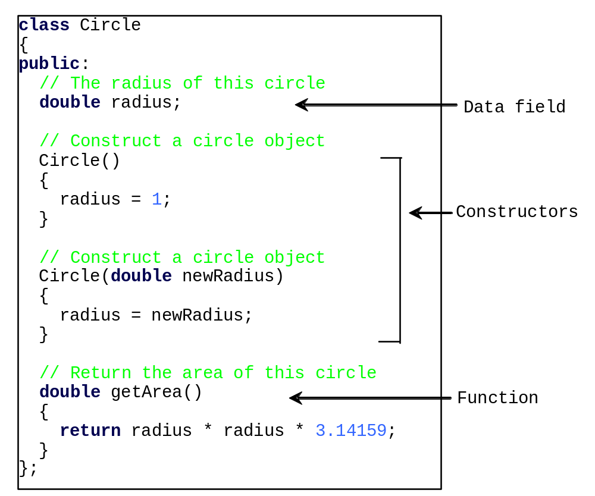
Classes

Slide 16
#include <iostream>
using namespace std;
class Circle
{
private:
// The radius of this circle
double radius;
public:
// Construct a default circle object
Circle()
{
radius = 1;
}
// Construct a circle object
Circle(double newRadius)
{
radius = newRadius;
}
// Return the area of this circle
double getArea()
{
return radius * radius * 3.14159;
}
}; // Must place a semicolon here
int main()
{
Circle circle1(1.0);
Circle circle2(25);
Circle circle3(125);
cout << "The area of the circle of radius "
" 1.0 is " << circle1.getArea() << endl;
cout << "The area of the circle of radius "
“25 is " << circle2.getArea() << endl;
cout << "The area of the circle of radius "
“125 is " << circle3.getArea() << endl;
return 0;
}

Slide 17
OO Feature - Objects
An object is almost anything with the following characteristics
  Name
  Properties
  Operations
  The ability to act upon receiving a “message” – being called by a function or another object.
    Basic message types
      Directive to object to perform an action
      Request to object to change one of its properties

Slide 18
Class Data Types
The Class construct
- Actually allows programmers to define new data types for representing information
- Class type objects can have both attribute and behaviour components
- Provides the object-oriented programming in C++

Slide 19
Terminology
Object behaviours
- Realized in C++ via member functions (aka methods)
- Methods are public – accessible from outside the class
Object attributes
- Are known as data members in C++
- Attributes are private – only accessible to class members

Slide 20
Any part of the program should be able to call the member functions – so they are in the public section.
Data members are defined in the private section of the class.
- Only member functions of the class can access them.
- They are hidden from the rest of the program.
So that outside functions may access the data members, we provide special functions in the class to form an interface – accessors and mutators.

Slide 21
Object Names
You assign an object a name when creating the object.
A special class function called the class constructor is invoked when an object is created.
The syntax to create an object using the constructor is
ClassName objectName;
For example,
Circle circle1;
for some class Circle
Note that a constructor has the same
name as the class.

Slide 22
Access Operator
After an object is created, its data can be accessed and its functions invoked using the dot operator .
objectName.dataField references a data field of the object.
objectName.function(arguments) invokes a function of the object.

Slide 23
Private versus Public
Public member functions allow “clients” to operate on the objects of a class.
May have private member functions
  If member functions need to call another function that is part or not part of the class then it should be private
Use care when defining public access

Slide 24
Information hiding recommends that data members should be private
- not freely accessible by clients
So, in order for clients to read/write the values of the data members
of an object, must provide so-called get and set functions
- get – read value
- set – write value
The only way clients may access the data members.

Slide 25
Accessor and Mutator
Colloquially, a get function is referred to as a getter (or accessor), and a set function is referred to as a setter (or mutator).
A get function has the following signature (Only a convention!):
returnType getPropertyName()
A set function has the following signature (only a convention!):
public void setPropertyName(dataType propertyValue)

Slide 26
Classes
class NameOfClass
{
public:
// The “public” interface – available to clients
// Here we define the public methods of the class
private:
// the data members – only accessible by functions of the class
};

Slide 27
Remember
Every class object
- Has its own data members
- Has its own member functions (which are the same as other objects of the same class have)
- When a member function accesses a data member
By default the function accesses the data member of
the object to which it belongs!
- No special notation needed

Slide 28
class Person
{
private: string name;
int age;
public: void setData()
{
cout << “\nEnter name:”; cin >> name;
cout << “\nEnter age:”; cin >> age;
}
void getData()
{
cout << “\nName:” << name << ”\t\tAge:” << age;
}
};
No constructor here!

Slide 29
// Statements to define instances of the Person class:
// Objects named Ivan and Elena
Person Ivan, Elena;
// Array of Person objects named family with size of 5
Person family[5];

Slide 30
// Statements to call members (data and methods) of the Person class:
// Private members cannot be called from outside the class
// Public members can be called from inside and outside the class
Ivan.setData();
Ivan.getData(); // OK
Ivan.age = 19; // Error

Slide 31
Example – better!
class Person
{
private: string name;
unsigned age;
public:
string getName() { return name; }
unsigned getAge() { return age; }
void setName(string par){name = par;}
void setAge(unsigned par){age = par;}
};

Slide 32
Constructors
Special member function
  Same name as class name
Constructor is invoked each time an object is declared for a given class
Initializes object

Slide 33
Constructor
The constructor has exactly the same name as the defining class.
A class normally provides a constructor without arguments - default constructor.
Like regular functions, constructors can be overloaded (i.e. multiple constructors with the same name but different signatures), making it easy to construct objects with different initial data values.
A class may be declared without constructors.
- In this case, a default constructor, is provided automatically but only if no constructors are explicitly declared in the class.

Slide 34
Constructing with Arguments
Constructors may be overloaded
The syntax to declare an object using a constructor with parameters is
ClassName objectName(parameters);
For example, the following declaration creates an object named circle2 by invoking the Circle class’s constructor with a specified radius 5.5.
Circle circle2(5.5);

Slide 35
Classes
To define a class you write:
class NameOfClass
{
public:
// the public interface
private:
// the data members
};

Slide 36
Any part of the program should be able to call the
member functions – so they are in the public section.
Data members are defined in the private section of the class.
Only member functions of the class can access them.
- They are hidden from the rest of the program.
class NameOfClass
{
public:
// the public interface
private:
// the data members
};

Slide 37
Here is the C++ syntax for a CashRegister class definition:
class CashRegister
{
public:
void clear();
void add_item(double price);
double get_total() const;
int get_count() const;
private:
// data members will go here
};

Slide 38
The public interface has the four activities that we decided this object should support.
class CashRegister
{
public:
void clear();
void add_item(double price);
double get_total() const;
int get_count() const;
private:
// data members will go here
};
Notice that these are just declarations. They will be defined later.

Slide 39
You call the member functions by first creating a variable of type CashRegister and then using the dot notation:
Because these are mutators, the data members in the object will be changed.
CashRegister register1;
...
register1.clear();
...
register1.add_item(1.95);

Slide 40
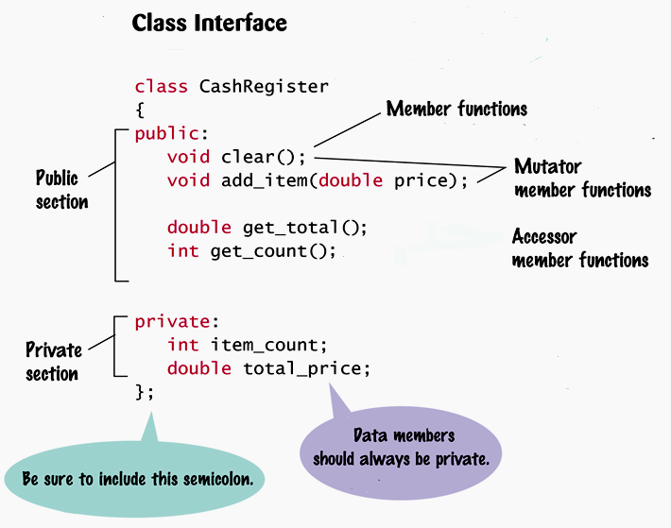

Slide 41
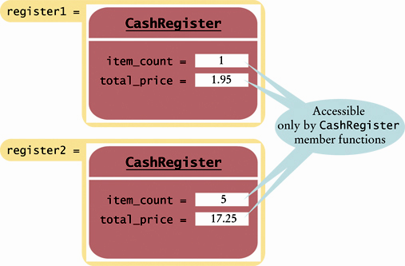
Every CashRegister object has its own copy of the data members

Slide 42
The Philosophy of Private Data Members
More “secure” programs – not “abused” by clients.
Example: if we use private, we can write a mutator for item_count so that item_count cannot be set to a negative value.
If item_count were public, it could be directly set to a negative value by some misguided (or worse, devious) programmer.

Slide 43
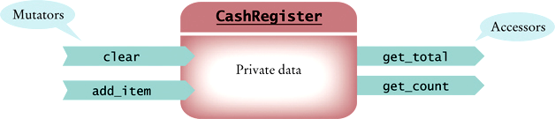
The interface for our class:

Slide 44
Implementing the Member Functions
The details of the add_item member as a regular function:
void add_item(double price)
{
item_count++;
total_price = total_price + price;
}
However, to specify that a function is a member function of your class you must write
CashRegister::
in front of the member function’s name:

Slide 45
void CashRegister::add_item(double price)
{
item_count++;
total_price = total_price + price;
}

Slide 46
Implementing the Member Functions
Use CashRegister:: only when defining the function – not in the class definition.
class CashRegister
{
public:
...
private:
...
};
Not here
Only here
void CashRegister::add_item(double price)
{
item_count++;
total_price = total_price + price;
}
Function definition

Slide 47
Often, separate the class definition from the implementation
- Put in separate files
- Class definition in a header file with .h extension
- Implementation in a source file with a .cpp extension
- In main(), have
#include “ClassName.h”

Slide 48
Constructors
The name of a constructor is identical to the name of its class
class CashRegister
{
public:
CashRegister(); // A constructor
...
};

Slide 49
Constructors
There must be no return type, not even void.
class CashRegister
{
public:
CashRegister(); // A constructor
...
};

Slide 50
Constructors
And, of course, you must define the constructor.
CashRegister::CashRegister()
{
item_count = 0;
total_price = 0;
}

Slide 51
Constructors
Constructors can have parameters, and constructors can be overloaded:
class BankAccount
{
public:
// Sets balance to 0
BankAccount();
// Sets balance to initial_balance
BankAccount(double initial_balance);
// Member functions omitted
private:
double balance;
};

Slide 52
Constructors
BankAccount Ivans_account;
// Uses default BankAccount constructor
BankAccount Elenas_account(499.95);
// Uses BankAccount(double) constructor

Slide 53
Inheritance - Implementing Derived Classes
The : symbol denotes inheritance.
Derived class
Parent:
the base class
class ChildClass : public ParentClass
{
public:
// New and changed member
// functions will go here
private:
// Additional data members
// will go here
};

Slide 54
The derived class inherits all data members and all functions of the base class that it does not override.
Override by re-defining data members and member functions in derived class.

Slide 55
Function Overloading and Polymorphism
Having functions with the same name is called function overloading
Polymorphism is what allows functions with the same name to do different things based on its arguments.
Polymorphism is available for objects.

